Slide 1
Friendly CryptoJam: A Mechanism for Securing Physical-Layer Attributes
Hanif Rahbari and Marwan Krunz
Department of Electrical and Computer Engineering
University of Arizona
ACM WiSec 2014

Slide 2
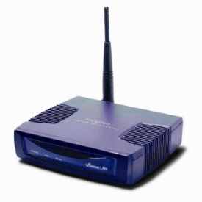



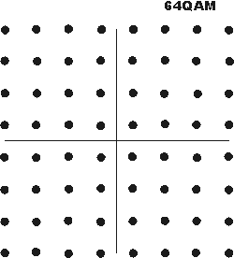
Motivation
Even when encrypted, wireless transmissions reveal information
  Side-channel information (e.g., packet duration, inter-packet times, modulation scheme, traffic volume, etc.), or
  Unencrypted low-layer fields (e.g., ‘type’ field in the 802.11 MAC header, ‘rate’ field in 802.11 PHY header, …)
  Encrypted but semi-static fields (encryption results in a few possible outputs; can be pinned down via a dictionary attack)
Leaked info can be used in passive and active attacks
IPT
size
P R L
P R L
P R L
payload
P R L
Mod. scheme
… Rate …

Slide 3


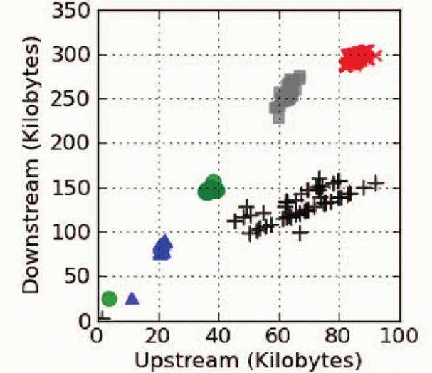
Examples of Privacy Attacks
Assume payload is encrypted (e.g., WPA2, IPSec, HTTPS, etc.)
1) Naïve Bayes classification attack
(uses traffic volume & directionality)
3) Google’s auto-suggestion vulnerability
  Search for “guns”
wikileaks.org
x
x+1
x+2
x+3
Downstream (Kilobytes)
www.cnn.com
y+97
y+85
y+21
y
guns
gun
gu
g
Skype
Upstream (Kilobytes)
Browsing
[Dyer et al., SP’12]
2) Application classification attack
(uses frame-size statistics, # of frames, and directionality)
  Hierarchical (decision-tree) classification structures
  5-second eavesdropping on encrypted MAC traffic
  ➔ 80% classification accuracy
Watching video
Downloading
BitTorrent
Chatting
Gaming
Uploading
Notes:
1-min eavesdropping ➔ 90% classification accuracy

Slide 4



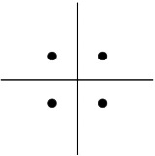
Example of an Active Attack
Rate-adaptation attack [Noubir et al., WiSec’11]
P R L
P R L
P R L
Retransmission
… Rate …
… Rate …
1
2
Notes:
A rate-adaptive wireless transmitter tries to achieve channel capacity
Adversary targets high-rate frames (easier to jam, forces Tx to reduce trans. rate)
Rate obtained from: (1) PHY header, or (2) detected payload’s mod. Scheme
The victim is identified and tracked by reading its (unencrypted) MAC address

Slide 5
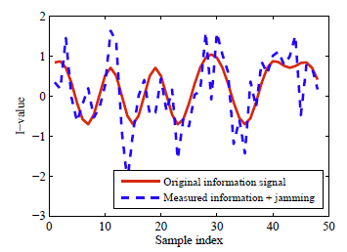
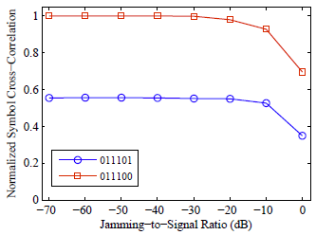
Existing Countermeasures
Friendly jamming / Artificial noise (with MIMO or relay nodes)
  Ineffective against: (1) plain-text attack, (2) cross-correlation attack
Padding
  (1) Effective in hiding traffic volume & packet size but with 100-400% overhead
  (2) Ineffective in hiding unencrypted headers and the modulation scheme
Digital encryption (block ciphering)
  (1) In a networked scenario, digital encryption is limited to MAC payload
  (2) Ineffective in hiding mod. scheme and semi-static fields (dictionary attack)
Normalized Symbol
Cross-Correlation
I-value
Correct value
Sample index
Jamming-to-Signal Ratio (dB)
Notes:
PLAIN-TEXT ATTACK: Eve uses known part of a frame to estimate the secret Alice-Bob channel signature used to generate the jamming signal and then extract the data signal from the received superposition [Schulz et al., NDSS’14]
CROSS-CORRELATION ATTACK [one of our contributions]: Semi-static fields are detected even after the addition of an independent jamming signal
With Block cyphering, MAC header cannot be encrypted in a network since MAC address cannot be used for pulling up the right decryption key

Slide 6

Design Goals of Friendly CryptoJam
1st Goal: Maintain interoperability with current systems
  “Add-on” module
  Keep same set of modulation schemes
Must know supported modulation schemes and preamble structure
Challenges:
  Must have minimal impact on the acquisition of wireless parameters
    Ex: Frequency offset, frame timing, channel estimation, …
  Must be done at the symbol level
01010101 …
802.11
FCJ
Notes:
To mitigate privacy leakage & various rate-dependent attacks.
802.11 is just an example. Then scheme can be generalized.

Slide 7
Design Goals of Friendly CryptoJam (Cont’d)
2nd Goal: Hide unencrypted/semi-static encrypted PHY/MAC headers
Implications:
  Use symbol-level stream cipher that is robust to cross-correlation attacks
  Keys must vary on a per-frame basis to counter dictionary attacks
  Must be able to identify senders without their (encrypted) MAC addresses
Challenges:
  How to convey per-frame IDs for pulling up the right decryption key before the arrival of the PHY header
  How to generate an unpredictable cipher-text for each frame
Preamble
PHY header
MAC header
Payload
Notes:
To mitigate privacy leakage & various rate-dependent attacks.
In contrast to conventional encryption, which requires the MAC address to find the right key and applies complex “block” ciphering on the bit level, modulation encryption is a simple “stream” ciphering with fast decryption speed.
(Block ciphering in not applied on the PHY header. The receivers decodes the PHY header on the fly while receiving it.)
With a public-private key ciphering, the adversary can create a “dictionary” of encrypted headers because 1) the public key is publicly known and 2) some of the header fields have finite values. (For example, MAC address has 2^32 possible values. The adversary can compute the cipher-text of the all the values only ONCE and then make a dictionary).
Exploit the known preamble to convey frame ID

Slide 8
Design Goals of Friendly CryptoJam
3rd Goal: Hide modulation scheme without sacrificing throughput
  Decorrelate packet size from frame duration
  Maintain same BER performance
Idea:
  Upgrade payload’s mod. scheme to the highest
  modulation order using a secret sequence
Challenges:
  Upgrading the modulation scheme may degrade data rate
  Rx needs to recover the original modulation symbols
64-QAM
BPSK
QPSK
16-QAM
64-QAM
Notes:
Modulation scheme can reveal the data rate. ➔ Frame duration (in seconds) together with the rate can specify the packet size (in bytes).
→ Incorrect modulation scheme detection results in wrong packet size estimation.

Slide 9
Friendly Jamming vs. Collisions
Friendly jamming signal is controllable but independent of the data
  Under existing friendly jamming schemes, an information frame can still be partially or fully recovered by a MIMO-capable adversary
Collision is uncontrollable
  Jamming signal is modulated with a structured modulation
  Theoretically, collided frames are not recoverable
  Superposition of modulated signals creates a new constellation map
  Example: Superposition of two QPSK-modulated signals
+1
+2
+1
-1
+1
-1
+1
-2
+2
-1
-1
-2
The new map may reveal the original modulation scheme(s)
Notes:
Friendly jamming vulnerabilities: 1) If beamforming is used, the precoding matrix can be extracted. 2) Semi-static fields will be estimated though estimation techniques. 3) If random noise is used, the structure of the constellation map still leaks the modulation scheme.
Simply superposing two frames is not sufficient to hide the original modulation schemes.
New waveform may not be supported by the underlying system.

Slide 10
Friendly CryptoJam in a Nutshell
Fusion of symbol-level cryptography and “non-extractable” friendly jamming (with jamming in the form of signal combining/collision)
Main Elements:
  1) Modulation Encryption: Randomizes locations of modulated symbols to protect unencrypted and semi-static encrypted headers
  2) Modulation Unification: Randomly “upgrades” a modulated symbol to hide the true modulation scheme (and hence, packet size)
  3) ID Embedding: Embeds a frame-specific ID in the preamble: P ➔ P*=P+ID
  (identifies sender + maintains synchrony in secret generation of “bogus traffic”)
Enc. QPSK
16-QAM
QPSK
01
11
Mod.
Encryption
00
01
+1
+1
Mod.
Unification
-1
+1
-1
+1
-3
-1
+1
+3
00
-1
10
11
-1
10
Notes:
In contrast to conventional encryption, which requires the MAC address to find the right key and applies complex “block” ciphering on the bit level, modulation encryption is a simple “stream” ciphering with fast decryption speed.
ID has two functions: sender identification (since MAC address is mod. Encrypted) and (2) synchronize Alice and Bob within the same PN sequence

Slide 11
System Model (802.11b)
Modulation Encryption
Modulation Unification
ID Embedding
Scrambled 1’s
CSI
Rate
1
Modulation
2
3
Compute and prepend header
Coding / Scrambling
Modulation
Prepend
preamble
Payload

Slide 12
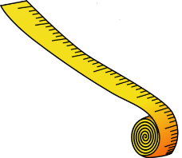



Example
Encrypt. Payload
400 bytes
Encrypt. Payload
150 bytes
Before FCJ
BPSK
16-QAM
P
hdr
P
hdr
Mod. encrypted
Mod. encrypted
After FCJ
64-QAM
64-QAM
P*
P*
hdr
hdr
Eve’s belief:
$600$ bytes
$900$ bytes
Information rate remains the same
Payload size decorrelated from frame duration ➔ packet-size obfuscation

Slide 13
Bogus Traffic Generation
Replaces the jamming signal and is interleaved with the data symbols
Let |R| be # of constellation points of a modulation scheme R
Let M be the highest-order modulation order
Generate a random secret sequence of 0s/1s
Divide sequence into blocks of log₂|M| bits
  log₂|R| used for modulation encryption
  Remaining log₂(|M|/|R|) bits used for mod. unification
1 0 0 0 1 0 1 1 0 1 0 0 0 1 0 1 1 0 1 1 0 0 1 0 1 1 0 1
Encryption
Unification
QPSK
64-QAM
Notes:
Bogus traffic should be secure and different from one frame to another

Slide 14

Modulation Encryption
Applies to modulated symbols of unencrypted PHY/MAC header fields
  Encryption function: $z=(x+y)$ mod |R|
  Decryption function: $y=$ (|R| $−(z−x))$ mod |R|
Example:
Encryption function
R = QPSK
01
11
00
01
y x | 0 | 1 | 2 | 3
0 | 0 | 1 | 2 | 3
1 | 1 | 2 | 3 | 0
2 | 2 | 3 | 0 | 1
3 | 3 | 0 | 1 | 2
+1
+1
-1
+1
-1
+1
00
-1
10
11
-1
10
1 0 0 0 1 0 1 1 0 1 0 0 0 1 0 1 1 0 1 1 0 0 1 0
Bogus traffic (x):
2
2
1
1
2
0
Data symbols (y):
3 0 2 0 1 3
Encrypted symbol:
1 2 0 1 3 3
Notes:
Let and be the decimal values corresponding to symbol values of the bogus frame and the information frame, respectively
Encryption function: $z=(x+y)$ mod |R|
Decryption function: $y=$ (|R| $−(z−x))$ mod |R|
Encryption function provides perfect secrecy because an observed z could correspond to all the possible x’s (i.e., observing z does not decrease entropy and mutual information is zero).
Encryption function does not need to use any constellation point other than the original points.
Encryption function is symmetric (x and y are interchangeable).
Encryption function is a form of stream cipher, with which encryption/decryption is fast.
Note: Modulation unification function (next slide) is not secret. So if the original modulation scheme is known (e.g., for the PHY-header), Eve can recover original points using the inverse of unification function. Hence, unification is not sufficient to protect the PHY header.

Slide 15
Modulation Unification
For every R-modulated information symbol, there are |M|/|R| possible points on the constellation map of M
  Each possibility is selected based on value of unification bits
An optimal mapping maximizes the avg. pairwise distance between the resultant points so as to reduce demodulation error
R = QPSK
M = 16-QAM
01
11
Mod.
Unification
+1
01
11
-1
+1
-1.34
-0.44
+0.44
+1.34
-1
00
10
00
10
Symbols correspond to one given unit of unification bits
Notes:
Even with the optimized mapping (which maintains the same energy per symbol), the distance between a pair of constellation points is reduced compared to the case without upgrade. Hence, the BER will be higher. To maintain the same SER, power must be increased.
In this example, minimum distance decreases from 2 to 1.78.

Slide 16
Modulation Unification (cont’d)
R = BPSK
M = 16-QAM
0
Mod.
Unification
0
1
-0.95
-0.32
+0.32
+0.95
-1
+1
1
Notes:
In this example, minimum distance decreases from 2 to 1.8.

Slide 17
Implication on Transmission Power
Friendly CryptoJam comes at a cost in transmission power
  Optimal modulation upgrade may not preserve original distances
    ➔ higher information BER at Bob
  Mapping used for mod. encryption destroys Gray code structure
must boost transmission power to maintain same BER
For the set of {BPSK, QPSK, 16-QAM, and 64-QAM}, only 1.2 dB increase in transmission power is needed
00
01
mod.
unification
+1
+1
-1
+1
-1
+1
-0.44
0.44
1.34
11
-1
10
-1
Gray code violation
Notes:
d(QPSK) = 2 ➔ 1.34+0.44=1.78

Slide 18
Synchronous Generation of Bogus Traffic
Secure hash function (e.g., SHA-2) is used to generate bogus traffic
  Requires a seed value; the receiver should have it before getting PHY header
  1-bit change in seed changes the whole sequence (i.e., it is difficult to guess)
  One-way function (hashed value cannot be used to recover the initial value)
Idea: Embed a part of the seed (frame ID) in the preamble, which has a known structure
  session key will be the other part of the seed
Session key
P*
hdr
k
ID
SHA-2
Bogus traffic
k | ID
01010101 …
seed
Notes:
A one-way hash function is a "known" hash function that maps a plaintext value to a hash value, but cannot do the reverse (i.e., it is hard to obtain its inverse function)

Slide 19


Case Study: Embed ID in 802.11b Preamble
In 802.11b, the preamble is a series of Barker sequences
  A Barker sequence has a low cross correlation with its shifted versions
Embed ID as a concatenation of cyclically shifted versions: P*=P+ID
  Embedded message does not impact normal functions of the preamble
    (1) Frame detection
    (2) Frequency offset estimation
    (3) Channel estimation
Example (1 bit in preamble):
Cross-correlation w/o FCJ:
Cross-correlation with FCP:
P:
+1 | -1 | +1 | +1 | -1 | +1 | +1 | +1 | -1 | -1 | -1
ID $=2$
-1 | -1 | +1 | -1 | +1 | +1 | -1 | +1 | +1 | +1 | -1
P*:
0 | -2 | +2 | 0 | 0 | +2 | 0 | +2 | 0 | 0 | -2
Notes:
Preamble is DBPSK modulated. Every bit on the preamble is spread (modulated) using the 11-chip Barker sequence (DSSS). ID uses the same modulation, but after cyclically shifting the Barker sequence. Shifted versions with different shift values correspond to different IDs.
The original preamble and its shifted versions can be successfully used for frame detection and message extraction, respectively.
To detect a frame, Alice does not need to know what ID is embedded.

Slide 20
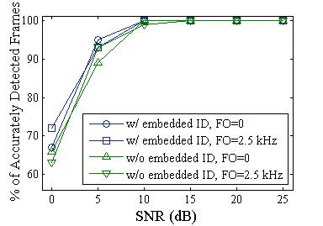
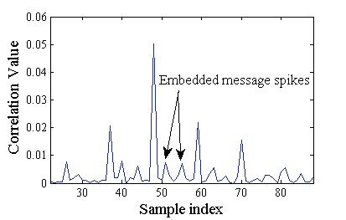
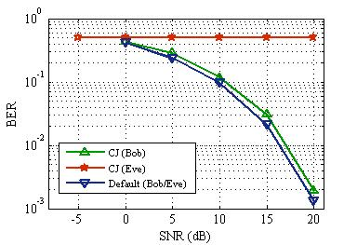
Performance Evaluation (Simulations)
802.11 system with four Barker sequences (4-bit preamble)
Frame detection and ID extraction:
    Bob runs a sliding-window cross-correlation
    Spikes due to embedded ID are detectable and
    also distinguishable from main spike
BER performance (QPSK):
  Eve cannot decode originally unencrypted fields
  Bob, however, performs almost as good as default
  With FCJ, Alice needs a slight power boost (~1 dB)
% of Accurately Detected Frames
Embedded Message Spikes
SNR (dB)
BER
SNR (dB)
Notes:
The figure to the left has been obtained from the USRP experimantations

Slide 21
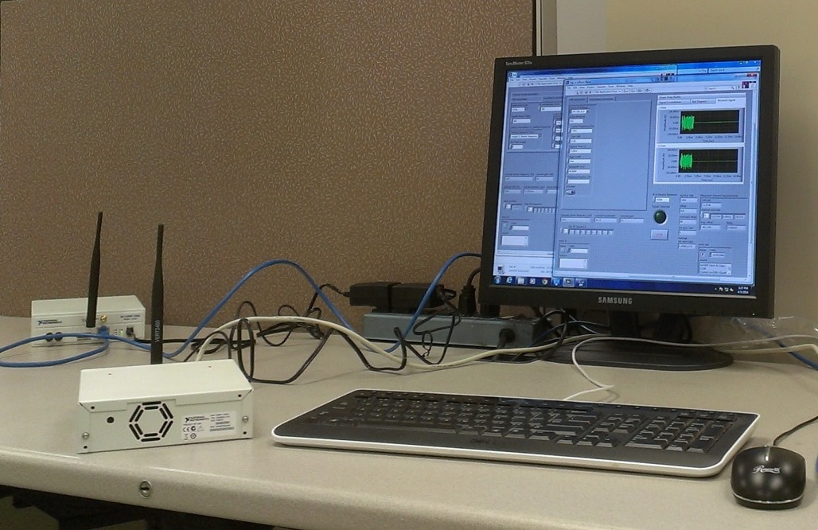
Experimental Setup
NI-USRP 2922 (Alice and Bob/Eve)
  1.2 meter distance with a cardboard box delimiter (not shown below)
LabVIEW programming environment

Slide 22
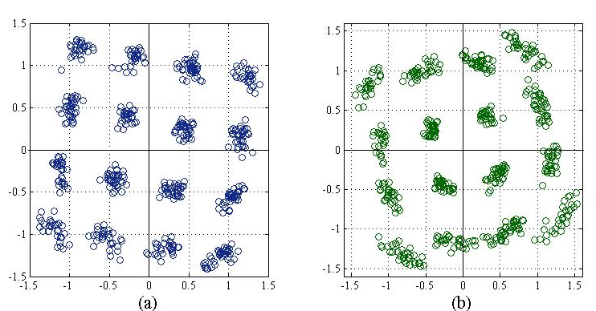
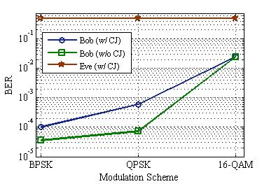
Performance Evaluation (USRP Experiments)
USRPs in an indoor environment
Received symbols at Bob/Eve:
  Original modulations: BPSK & QPSK
  Upgraded modulation: 16-QAM
To Eve, they both look 16-QAM
Same frame duration (3.64 ms) for different modulation schemes:
  BPSK: 250 bits, QPSK: 500 bits, 16-QAM: 1000 bits
  Eve cannot distinguish between packet sizes
  Successful modulation-encryption
BPSK → 16-QAM
QPSK → 16-QAM
BER
Modulation Scheme

Slide 23
Conclusions
With a slightly increased transmission power, Friendly CryptoJam can
  Encrypt the header fields at modulation level (perfect secrecy),
  Obfuscate the packet size, and
  Hide the modulation scheme;
but without
  Increasing the transmission time (no padding),
  Any significant overhead,
  Modifying the standard protocols on the devices (add-on feature).
Publicity of preamble can be exploited to embed a frame (session) ID
  Now the MAC address can be encrypted
Future work
  Extend to OFDM-based standards
  More complicated experimental scenarios

